Slide 1
Why the heck is healthcare so expensive?
Louis D. Johnston
Econ in English
September 21, 2016

Slide 2
Quick overview:
Health care spending
Competitive markets
Health care markets

Slide 3
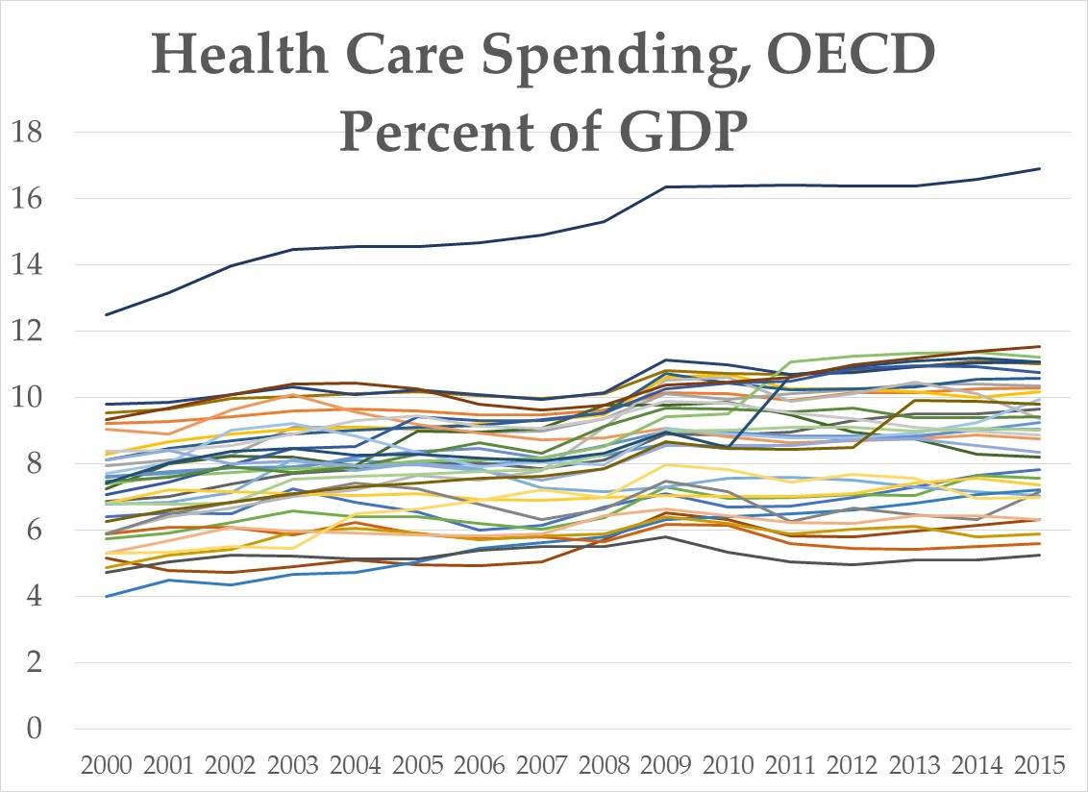

Slide 4
Competitive markets
All firms sell the same standardized product.
Buyers and sellers are price takers.
Buyers and sellers are well informed. (Complete and symmetric information)
Productive resources are mobile.
No externalities

Slide 5
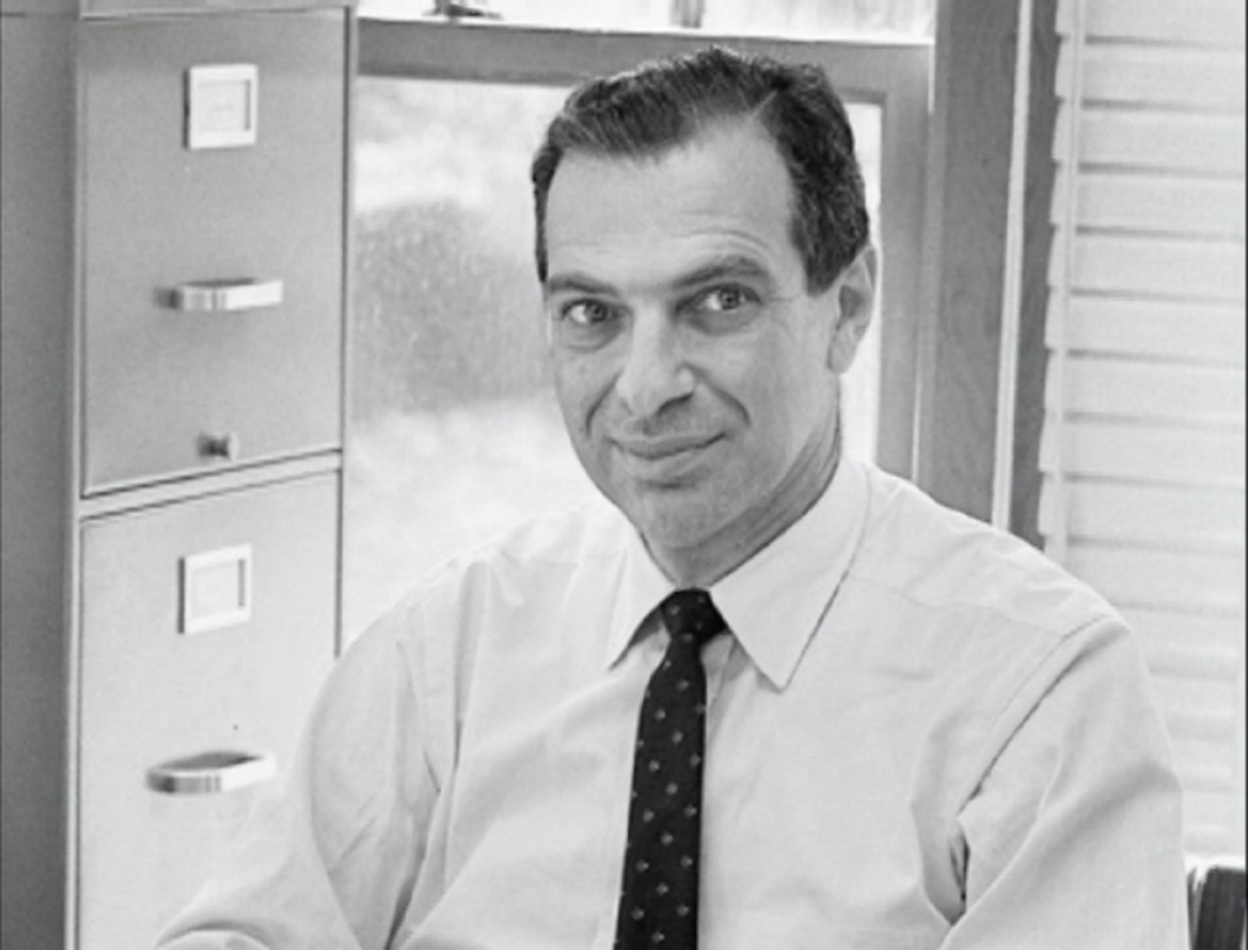
Kenneth Arrow
Nobel Laureate, 1972

Slide 7
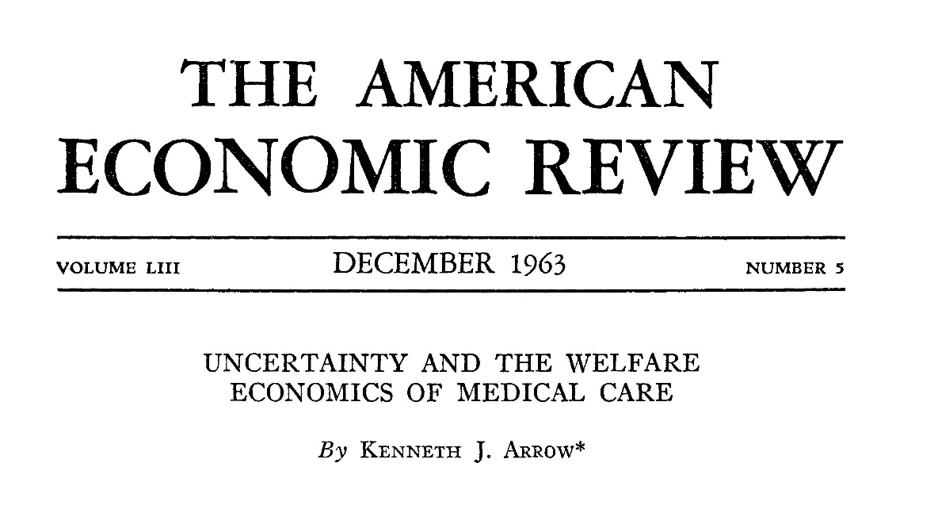

Slide 8
“Markets for medical care are different”
Product differentiation
Joint production
Market power and barriers to entry
Incomplete and asymmetric information
Externalities
Income elasticity

Slide 9
Four types of health care systems
YOYO: You’re on your own
Employer-provided insurance
Single-payer
Government financed and produced
PICK ONE!

Slide 10
Thanks for your attention and participation!

